Slide 1







CenturyLink Data & Analytics Architecture Framework
Governance, Metadata, security
acquisition & STAGING
Enterprise Reuse
Decision Support
Web and Social
Operational Systems
Message store
Messages & Streaming analytics
Machine Logs
Operational
Analytics
indexed data
Text
Graph Databases & document databases
Raw Data
Historical
Online Archival
Independent
Data
Marts
Images
Hadoop
Raw Data
Historical
Online Archive
Lightly Integrated
Curated
Discovery
Statistical Models
Machine Learning & Automation
Structured data unstructured data, big data
Data Scientists
Audio and Video
Business Analysts
Billing
Ordering
RDBMS
RDBMS
Highly Integrated
Normalized
Raw Data
Historical
Integrated
Normalized
By Subject
Business Intelligence
Reporting
Data Marts
Report
Developers
crm
erp
Customer Care
CONSUMPTION
Monitoring & Scheduling
Sources

Slide 2
CenturyLink Data & Analytics Architecture Framework
Governance, Metadata, security
acquisition & STAGING
Enterprise Reuse
Decision Support
Web and Social
Operational Systems
Messages & Streaming analytics
Machine Logs
Operational
Analytics
indexed data
Text
Graph Databases & document databases
Raw Data
Historical
Online Archival
Independent
Data
Marts
Images
Hadoop
Lightly Integrated
Curated
Discovery
Predictive Analytics
Statistical Models
Machine Learning & Automation
Structured data unstructured data, big data
Data Scientists
Audio and Video
Business Analysts
Billing
Ordering
RDBMS
Highly Integrated
Normalized
Integrated
Normalized
By Subject
Business Intelligence
Reporting
Data Marts
Report
Developers
crm
erp
Customer Care
CONSUMPTION
Monitoring & Scheduling
Sources

Slide 3
CenturyLink Data & Analytics Architecture Framework
Web and Social
acquisition & STAGING
Architecture Guidelines – Acquisition & Staging
Touch it, take it when one or more attributes are required from a source, all attributes and all rows will be extracted and loaded. Consider taking all tables or an entire schema if minimal incremental costs are incurred.
Minimal Transformations (dates, etc) – should look like the source. If a source field is transformed, keep the original value as well.
Move towards near real time data capture
Use original source whenever possible
Identify source data type – doc link
Keep History. Choose historical data pattern based on source data type and volume – doc link
Ingest/Raw (optional) is meant to be a transient area – Landing Zone
Once historical data pattern is applied, end result should be stored in Historical Processed Area. Not all data has to go through the Transient Landing Zone if this can be done in one step.
Choose appropriate data format (HIVE, HBASE, etc.) – doc link
Create a an archival strategy and implement as part of the initial development effort. doc link
Use Less Expensive Tier for Data Archival
Ensure Meta Data Tagging has been done
Hadoop
Operational Systems
Machine Logs
Transient
Landing Zone
(Ingest/Raw)
Text
Raw Data
Historical
Online Archival
Independent
Data
Marts
Images
Historical
Processed
(Ingest/Processed)
Data Scientists
Structured data unstructured data, big data
Audio and Video
Business Analysts
Billing
Ordering
RDBMS
Raw Data
Historical
Integrated
Normalized
By Subject
Report
Developers
crm
erp
CONSUMPTION
Customer Care
Sources

Slide 4







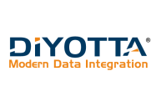


CenturyLink Data & Analytics Architecture Framework
Tools & Technology – Batch Ingestion
Leverage Automated Ingestion
HADOOP
Develop Ingestion Factory – Code Generator
Look at creating home grown or leverage new tools.
RDBMS
PL/SQL GETL (Generic ETL)
Informatica Template
Current Tools
Hadoop
Sqoop, Flume
RDBMS
Oracle PL/SQL
Informatica
Tools Targeted for Evaluation
Hadoop & RDBMS
Informatica Big Data Managment
Pentaho
Diyotta
Hadoop Only
Cask
Web and Social
acquisition & STAGING
Hadoop
Operational Systems
Machine Logs
Transient
Landing Zone
(Ingest/Raw)
Text
Raw Data
Historical
Online Archival
Independent
Data
Marts
Images
Historical
Processed
(Ingest/Processed)
Data Scientists
Structured data unstructured data, big data
Audio and Video
Business Analysts
Billing
Ordering
Ingestion Factory
RDBMS
Raw Data
Historical
Integrated
Normalized
By Subject
Report
Developers
crm
erp
CONSUMPTION
Customer Care
Sources

Slide 5
CenturyLink Data & Analytics Architecture Framework
acquisition & STAGING
Decision Support
Web and Social
Operational Systems
Message store
Messages & Streaming analytics
Machine Logs
Operational
Analytics
Indexed data
Text
Raw Data
Historical
Online Archival
Independent
Data
Marts
Images
Hadoop
Architecture Guidelines- Near Real Time Ingestion see doc
Ingest Data Near Real Time
Capture Data in Message Queue Once and “Share” with other data stores
If capturing data via Kafka for operational needs, also store in Hadoop
Leverage streaming analytics for real time analytics and actions
Raw Data
Historical
Online Archive
Lightly Integrated
Curated
Structured data unstructured data, big data
Data Scientists
Audio and Video
Business Analysts
Billing
Ordering
Highly Integrated
Normalized
Integrated
Normalized
By Subject
Report
Developers
crm
erp
Customer Care
CONSUMPTION
Sources

Slide 6






CenturyLink Data & Analytics Architecture Framework
acquisition & STAGING
Decision Support
Web and Social
Operational Systems
Message store
Messages & Streaming analytics
Machine Logs
Operational
Analytics
Indexed data
Text
Tools & Technologies - Near Real Time Ingestion see doc
Current Tools
Hadoop
Kafka, Flume
Spark Streaming (not actively used)
Tools Targeted for Evaluation
Hadoop & RDBMS
Rocana + StreamSets
StreamAnalytix
Raw Data
Historical
Online Archival
Independent
Data
Marts
Images
Ingestion Factory
Hadoop
Raw Data
Historical
Online Archive
Lightly Integrated
Curated
Structured data unstructured data, big data
Data Scientists
Audio and Video
Business Analysts
Billing
Ordering
Highly Integrated
Normalized
Integrated
Normalized
By Subject
Report
Developers
crm
erp
Customer Care
CONSUMPTION
Sources

Slide 7
CenturyLink Data & Analytics Architecture Framework
acquisition & STAGING
Enterprise Reuse
Decision Support
Web and Social
Operational Systems
Message store
Machine Logs
Operational
Analytics
indexed data
Text
Raw Data
Historical
Online Archival
Independent
Data
Marts
Images
Hadoop
Structured data unstructured data, big data
Data Scientists
Audio and Video
Architecture Guidelines - Indexed Data
For fast query and search performance, leverage indexed data sets.
Use indexed data to support operational analytics, primarily based off machine logs and supplemented with other reference data.
Leverage existing real time message stores for collecting real time data.
Leverage Hadoop for longer term storage as storing indexed data sets with some tools can be cost prohibitive.
Business Analysts
Billing
Ordering
Integrated
Normalized
By Subject
Report
Developers
crm
erp
Customer Care
CONSUMPTION
Sources

Slide 8



CenturyLink Data & Analytics Architecture Framework
acquisition & STAGING
Enterprise Reuse
Decision Support
Web and Social
Operational Systems
Message store
Machine Logs
Operational
Analytics
indexed data
Text
Raw Data
Historical
Online Archival
Independent
Data
Marts
Images
Hadoop
Structured data unstructured data, big data
Data Scientists
Audio and Video
Tools & Technologies - Indexed Data
Current Tools
Splunk
SOLR – see link
Tools to Evaluate
Rocana
Elasticsearch – see link
Business Analysts
Billing
Ordering
Integrated
Normalized
By Subject
Report
Developers
crm
erp
Customer Care
CONSUMPTION
Sources

Slide 9
CenturyLink Data & Analytics Architecture Framework
Architecture Guidelines – Enterprise Reuse on Hadoop
Lightly Integrated, Curated Data – Some moderate amount of integration will be required to “make sense of” the raw data in the staging environment for Decision Support. As those data sets become more widely used across the enterprise, they may become more formal in nature, resulting in a set of “enterprise reusable data assets”.
More ‘loosely modeled’ than traditional EDW structures, some de-normalization
Keys should still be able to link to other data sets in the Enterprise Reuse layer in Hadoop and in the RDBMS
Choose appropriate data format (HIVE, HBASE, etc.) – doc link
Enterprise Reuse
Web and Social
Operational Systems
Hadoop
Machine Logs
Operational
Analytics
Text
Raw Data
Historical
Online Archival
Independent
Data
Marts
Images
Lightly Integrated
Curated
Structured data unstructured data, big data
Data Scientists
Audio and Video
Business Analysts
Billing
Ordering
Integrated
Normalized
By Subject
crm
Report
Developers
erp
Customer Care
CONSUMPTION
Sources

Slide 10
CenturyLink Data & Analytics Architecture Framework
Architecture Guidelines - Decision Support on Hadoop
Discovery, Predictive Analytics, and Statistical Models are typically done by a data scientist role.
Discovery - Create a “sandbox” area to support data discovery by advanced business analysts and data scientists for data exploration.
Predictive Analytics & Statistical Models – The Hadoop environment, with its processing power, ability to leverage a variety of very large data sets supports advanced statistical modeling that is not as feasible in a traditional RDBMS environment.
Machine Learning & Automation – Leverage machine learning to find valuable insights hidden in vast amounts of varied data, and automate actions based on insights in a predictive fashion to get ahead of the game
Choose appropriate data format (HIVE, HBASE, etc.) – doc link
An eye towards the future – Continued expansion of Hadoop for general reporting – not yet mainstream
Decision Support
Web and Social
Operational Systems
Hadoop
Machine Logs
Operational
Analytics
Discovery
Predictive Analytics
Statistical Models
Machine Learning & Automation
Text
Raw Data
Historical
Online Archival
Independent
Data
Marts
Images
Structured data unstructured data, big data
Data Scientists
Audio and Video
Business Analysts
Billing
Ordering
Integrated
Normalized
By Subject
crm
Report
Developers
erp
Customer Care
CONSUMPTION
Sources

Slide 11
CenturyLink Data & Analytics Architecture Framework
Tools & Technologies – Hadoop Decision Support
Discovery - Paxata
Predictive Analytics & Statistical Models – Spark ML, Jupiter Hub, Spark (Python, Scala, R, Java), Splunk ML Toolkit
Machine Learning & Automation – IBM Watson
Decision Support
Web and Social
Operational Systems
Hadoop
Machine Logs
Operational
Analytics
Discovery
Predictive Analytics
Statistical Models
Machine Learning & Automation
Text
Raw Data
Historical
Online Archival
Independent
Data
Marts
Images
Structured data unstructured data, big data
Data Scientists
Audio and Video
Business Analysts
Billing
Ordering
Integrated
Normalized
By Subject
crm
Report
Developers
erp
Customer Care
CONSUMPTION
Sources

Slide 12
CenturyLink Data & Analytics Architecture Framework
Architecture Guidelines – RDBMS Enterprise Reuse & Decision Support
Move towards fewer RDBMS instances, using schemas to organize sets of data vs. putting data in independent data stores. This improves performance and ease of use to join key data sets together and reduces the need to copy data to different environments
Enterprise Reuse (Warehouse)
Organized by data domain
Merge like domain data together
Link data to other domains
Decision Support (Marts)
Primarily created from Enteprise Reuse Layer if possible.
Organized by business needs
Optimized structure for used case
May merge data domains
Can be detailed or summarized
Encourage business data marts to be built in schemas to reduce silo’d data marts
Enterprise Reuse
Decision Support
Web and Social
Operational Systems
Machine Logs
Operational
Analytics
Text
Independent
Data
Marts
Images
Structured data unstructured data, big data
Data Scientists
Audio and Video
Business Analysts
Billing
Ordering
RDBMS
Highly Integrated
Normalized
Integrated
Normalized
By Subject
Business Intelligence
Reporting
Data Marts
Report
Developers
crm
erp
Customer Care
CONSUMPTION
Sources

Slide 13
CenturyLink Data & Analytics Architecture Framework
Tools & Technologies – RDBMS Enterprise Reuse & Decision Support
Cross Platform ETL Tool (Informatica Big Data Edition, etc.)
BI Tools (Qlikview, Tableu, Business Objects)
Enterprise Reuse
Decision Support
Web and Social
Operational Systems
Machine Logs
Operational
Analytics
Text
Independent
Data
Marts
Images
Structured data unstructured data, big data
Data Scientists
Audio and Video
Business Analysts
Billing
Ordering
RDBMS
Highly Integrated
Normalized
Integrated
Normalized
By Subject
Business Intelligence
Reporting
Data Marts
Report
Developers
crm
erp
Customer Care
CONSUMPTION
Sources

Slide 14
CenturyLink Data & Analytics Architecture Framework
Enterprise Reuse
Decision Support
Web and Social
Operational Systems
Machine Logs
Search
Operational
Analytics
Text
Raw Data
Historical
Online Archival
Independent
Data
Marts
Images
Structured data unstructured data, big data
Data Scientists
Audio and Video
Business Analysts
Billing
Ordering
Integrated
Normalized
By Subject
Report
Developers
crm
erp
Customer Care
CONSUMPTION
Sources

Slide 15
CenturyLink Data & Analytics Architecture Framework
Enterprise Reuse
Decision Support
Web and Social
Operational Systems
Machine Logs
Operational
Analytics
Graph Databases & document databases
Text
Raw Data
Historical
Online Archival
Independent
Data
Marts
Images
Structured data unstructured data, big data
Data Scientists
Audio and Video
Business Analysts
Billing
Ordering
Integrated
Normalized
By Subject
Report
Developers
crm
erp
Customer Care
CONSUMPTION
Sources

Slide 16
CenturyLink Data & Analytics Architecture Framework
Governance, Metadata, security
Architecture Guidelines –
Governance –
Should be business driven to be successful
Data Governance
Gartner defines information governance as the specification of decision rights and an accountability framework to ensure appropriate behavior in the valuation, creation, storage, use, archiving and deletion of information
Project Governance
Governance refers to the set of policies, regulations, functions, processes, procedures and responsibilities that define the establishment, management and control of projects, programs and portfolios.
MetaData
Enable users to locate the data they need so they can use it
Apply standard classifications at the table level
Allow crowd sourcing of definitions at the database, schema, table, and attribute level
Automatically populate from other repositories (e.g. Erwin)
Leverage data fabric functionality so that an end user does not have to know where the data physically is in order to use it
Search, Compose, Curate, and Collaborate
See Mick’s Deck
See Pat’s Deck
Security
See Mick’s Deck
Web and Social
Operational Systems
Machine Logs
Operational
Analytics
Text
Independent
Data
Marts
Images
Structured data unstructured data, big data
Data Scientists
Audio and Video
Business Analysts
Billing
Ordering
Integrated
Normalized
By Subject
crm
Report
Developers
erp
Customer Care
CONSUMPTION
Sources

Slide 17
CenturyLink Data & Analytics Architecture Framework
Governance, Metadata, security
Tools & Technology
Governance –
TBD
MetaData
Current Tools
Cloudera Navigator
CDMT
Tools to Evaluate
Alation – Data Catalog and Definition of Curated Data Sets
Waterline – Classification and Tagging
Security
Current Tools
Cloudera Navigator Audit
AD + Cloudera Sentry + Centrify
Data Encryption at Rest – Cloudera
Tools to Evaluate
Protegrity – Dynamic and Static Data Masking & Tokenization
Imperva – (Sensitive) Data Access Management
Web and Social
Operational Systems
Machine Logs
Operational
Analytics
Text
Independent
Data
Marts
Images
Structured data unstructured data, big data
Data Scientists
Audio and Video
Business Analysts
Billing
Ordering
Integrated
Normalized
By Subject
Report
Developers
crm
erp
Customer Care
CONSUMPTION
Sources

Slide 18
CenturyLink Data & Analytics Architecture Framework
Architecture Guidelines – Monitoring & Scheduling
Monitoring
Monitor Disk Space, Memory, Network I/O, User Activity, and Server Capacity
Create automated notification to action upon defined thresholds
Provide forecasting capability for longer term planning
See Deck
Scheduling
See Deck
Web and Social
Operational Systems
Machine Logs
Operational
Analytics
Text
Independent
Data
Marts
Images
Structured data unstructured data, big data
Data Scientists
Audio and Video
Business Analysts
Billing
Ordering
Integrated
Normalized
By Subject
Report
Developers
crm
erp
Customer Care
CONSUMPTION
Monitoring & Scheduling
Sources

Slide 19


CenturyLink Data & Analytics Architecture Framework
Tools & Technologies – Monitoring & Scheduling
Monitoring
Current Tools
Cloudera Manager
Qlikview Visualizations using data via Cloudera Manager API
Tools to Evaluate
Consider creating historical database with Cloudera Manager Data
TBD
See deck
Web and Social
Operational Systems
Machine Logs
Operational
Analytics
Text
Independent
Data
Marts
Images
Structured data unstructured data, big data
Data Scientists
Audio and Video
Scheduling
Current Tools
HUE Workflow Builder and Oozie
DNA Agile Scheduler (In House Developed Tool)
Tools to Evaluate
See Cross Platform ETL Tools and Evaluate Schedulers within those tools
Others TBD pending Cross Platform ETL Tool Evaluation
Business Analysts
Billing
Ordering
Integrated
Normalized
By Subject
Report
Developers
crm
erp
Customer Care
CONSUMPTION
Monitoring & Scheduling
Sources

Slide 20

ARCHITECTURAL FRAMEWORK EVOLUTION
Governance
Metadata
security
Operational Systems
erp
Advocated Positions
All data in the Integration Layer needs to be sourced from the Acquisition Layer. Data cannot be sourced into the Integration Layer directly from the source systems.
Current Only - History only if requirements dictate, also take size/recreatability into account (if the data is small enough to create history from historical ingestion data, the need to keep history is less)
Plus
Reversibility and Traceability: enable auditability, traceability and reversibility i.e. full lineage from the point of consumption, across the analytic environment to its source system, with the ability to reverse out and correct any errors in any of the governed layers, for all governed data.
Independent
Data Marts
scm
Hadoop
Lightly Integrated
Curated
crm
Images
Business Users
Audio and Video
Report
Developers
Machine Logs
Business Analysts
RDBMS
Text
Normalized
Integrated
Data Scientists
Web and Social
Users
Customer Care
Sources

Slide 21
ARCHITECTURAL FRAMEWORK EVOLUTION
Governance
Metadata
security
Operational Systems
erp
Advocated Positions
Hadoop
Independent
Data Marts
scm
Lightly Integrated
Curated
Discovery
Predictive Analytics
Statistical Models
crm
Images
Business Users
Audio and Video
Report
Developers
Machine Logs
RDBMS
Business Analysts
Text
Business Intelligence
Reporting
Data Scientists
Web and Social
Users
Customer Care
Sources

Slide 22
Data Movement
Design Patterns
ARCHITECTURAL FRAMEWORK EVOLUTION
Governance
Customer Care
erp
Operational Systems
Move
Manage
ACCESS
Campaign Management
scm
Optus
Staff
crm
DATA
lake
Integrated Environment
Enterprise Reporting
Business Intelligence
Ad-Hoc reporting
Visualization
Operational Intelligence
Business Users
Images
Fast Loading
Ad-Hoc Analysis
Audio and Video
Batch
Filtering, Processing, ELT
Data Preparation environment
Report
Developers
Batch
Cleanse
Enrich
Standardize
Advanced Modelling
Machine Logs
Stream
Online Archival
Batch
Business Analysts
Data Discovery
Text
Batch
Stream
Discovery Capability
Stream
Data Scientists
Web and Social
Interactive Capability
Discovery Analytics
Path, graph, time series analytics
Predictive Analytics
Visualization
Big Data Analytics
Real Time Processing
Analytic tools & Apps
Users
Sources

Slide 23
ARCHITECTURAL FRAMEWORK EVOLUTION
Governance
Metadata
security
Operational Systems
erp
Independent
Data Marts
scm
Hadoop
Raw Data
Archival
Historical
Lightly Integrated
Curated
crm
Images
Business Users
Batch
Audio and Video
Stream
Report
Developers
Message store
Machine Logs
Request/Response
Business Analysts
RDBMS
Text
Raw Data
Historical
Data Scientists
Web and Social
Users
Customer Care
Sources

Slide 24
Batch Design Patterns
ARCHITECTURAL FRAMEWORK EVOLUTION
Governance
Customer Care
erp
Operational Systems
Move
Manage
ACCESS
Campaign Management
scm
Optus
Staff
Use Cases:
crm
DATA
lake
Enterprise Reporting
Trigger on source tables
Inserts and Updates trigger the whole row into a “shadow” table – same as the real row + serial id, timestamp, action (I, U)
Sqoop the shadow table to Hive
Now have full history on every table
Images
Batch
Txn
Full Dump CDC
Business Users
Fast Loading
Ad-Hoc Analysis
Audio and Video
Operational Intelligence
Filtering, Processing, ELT
Report
Developers
Advanced Modelling
Machine Logs
Online Archival
Business Analysts
Data Discovery
Text
Real Time Processing
Data Scientists
Web and Social
Discovery Analytics
Path, graph, time series analytics
Predictive Analytics
Visualization
Big Data Analytics
Analytic tools & Apps
Users
Sources

Slide 25
Batch Design Patterns
ARCHITECTURAL FRAMEWORK EVOLUTION
Governance
Customer Care
erp
Operational Systems
Move
Manage
ACCESS
scm
Campaign Management
Optus
Staff
crm
DATA
lake
Enterprise Reporting
Fast Loading
Business Users
Images
Filtering, Processing, ELT
Ad-Hoc Analysis
Audio and Video
Batch
Txn
Full Dump CDC
Operational Intelligence
Report
Developers
Online Archival
Advanced Modelling
Machine Logs
Real Time Processing
Business Analysts
Data Discovery
Text
Discovery Analytics
Path, graph, time series analytics
Predictive Analytics
Visualization
Data Scientists
Web and Social
Big Data Analytics
Analytic tools & Apps
Users
Sources

Slide 26
ARCHITECTURAL FRAMEWORK EVOLUTION
Governance
Metadata
security
Operational Systems
erp
Use Cases:
Ideal Streaming Source
Event Based
Insert Only (Immutable)
Source of Record
Subject to OSS/BSS/CSS/EA Reco’s
Updatable Data Source
Longer term events
Tickets
Orders
Inventories/Reference
Network Inventory (e.g. ARM)
Location Inventory
Other
Grey Area
File based from external only daily or less
Event data consolidated into a database in non-eventf form(device data consolidated into an inventory database)
A database of insert-only events
Independent
Data Marts
scm
Hadoop
Raw Data
Archival
Historical
Lightly Integrated
Curated
crm
Images
Business Users
Audio and Video
Stream
Report
Developers
Machine Logs
Business Analysts
Text
Data Scientists
Web and Social
Users
Customer Care
Sources

Slide 27
Streaming Design Patterns
ARCHITECTURAL FRAMEWORK EVOLUTION
Governance
Customer Care
erp
Operational Systems
Move
Manage
ACCESS
Campaign Management
scm
Optus
Staff
Use Cases:
Ideal Streaming Source
Event Based
Insert Only (Immutable)
Source of Record
Subject to OSS/BSS/CSS/EA Reco’s
Updatable Data Source
Longer term events
Tickets
Orders
Inventories/Reference
Network Inventory (e.g. ARM)
Location Inventory
Other
Grey Area
File based from external only daily or less
Event data consolidated into a database in non-eventf form(device data consolidated into an inventory database)
A database of insert-only events
crm
DATA
lake
Enterprise Reporting
Images
Business Users
Fast Loading
Ad-Hoc Analysis
Audio and Video
Operational Intelligence
Filtering, Processing, ELT
Report
Developers
Stream
RT
NRT
Advanced Modelling
Machine Logs
Online Archival
Business Analysts
Data Discovery
Text
Real Time Processing
Data Scientists
Web and Social
Discovery Analytics
Path, graph, time series analytics
Predictive Analytics
Visualization
Big Data Analytics
Analytic tools & Apps
Users
Sources

Slide 28
Stream Design Pattern
ARCHITECTURAL FRAMEWORK EVOLUTION
Governance
erp
Move
Manage
ACCESS
scm
Optus
Staff
crm
Images
Business Users
Fast Loading
Audio and Video
Filtering, Processing, ELT
Report
Developers
Online Archival
Machine Logs
Real-Time Processing
Business Analysts
Text
Interactive Capability
Data Scientists
Web and Social
Discovery Analytics
Path, graph, time series analytics
Predictive Analytics
Visualization
Stream
Request & Response
Users
Sources

Slide 29
Interactive Design Pattern
SP-Simple
Provide a Simple Messaging – Publish/Subscribe – Capability.
Publishers able to publish completely independently of Subscribers.
Robust and Scalable
SP-Complex
Provide ability to perform numerous operations in sequence on a stream of data, making data from one step available to the next, etc.
SP-To Historical
Get the Streaming data to one or more Historical data stores.
D1 – Use SP-Simple or SP-Complex
D2 – Replicate Messages to Historical Store (or not) – our default will be Yes.

Slide 30
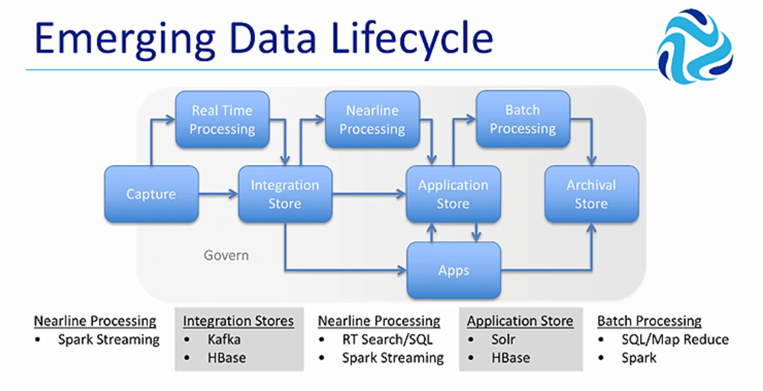
Interactive Implementation Alternatives
Kafka Streams
StreamSets
Sqoop

Slide 31
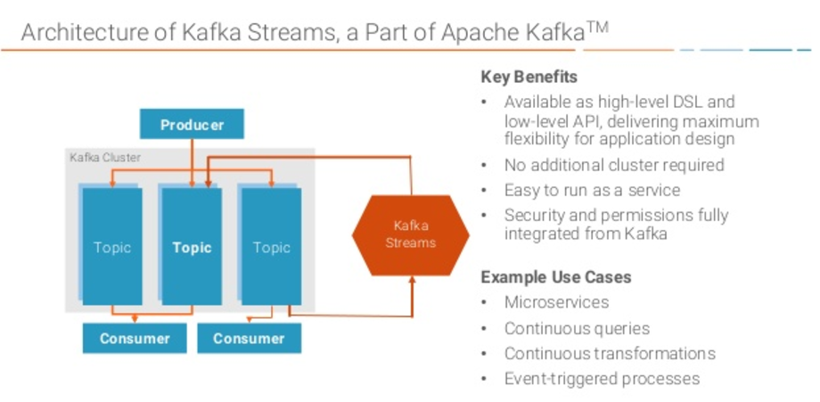
Stream – Implementation Alternatives

Slide 32
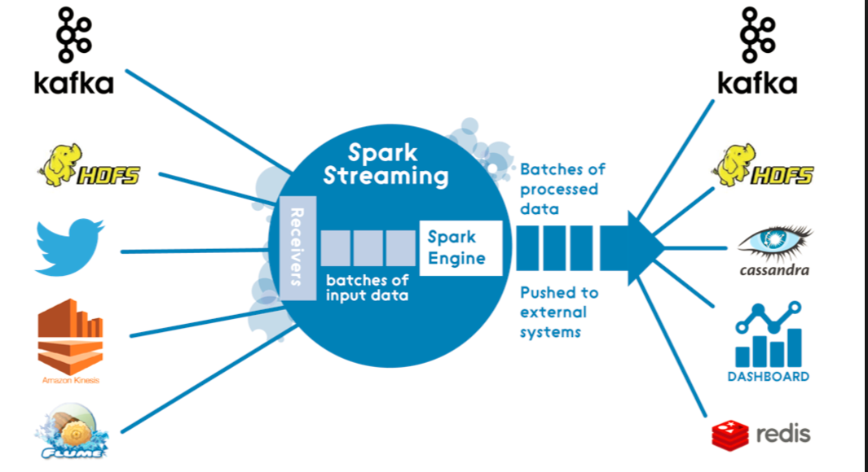
Stream – Implementation Alternatives

Slide 33
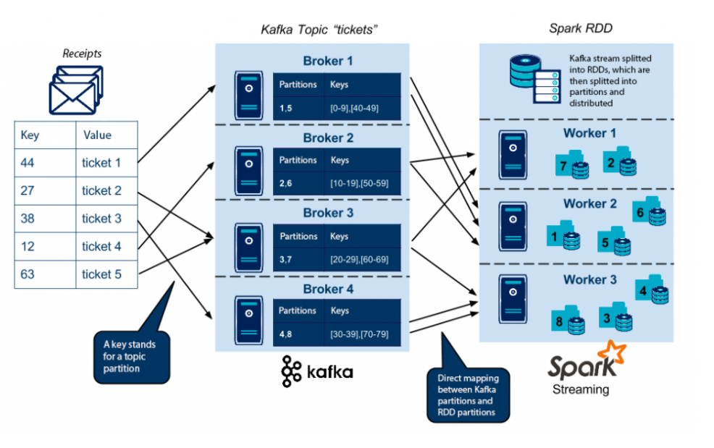

Slide 34
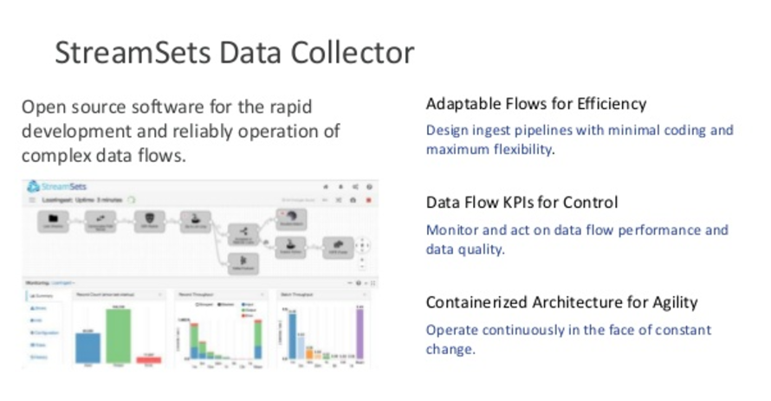
Stream – Implementation Alternatives

Slide 35



















Application Architecture
Application Architecture
Governance
Customer Care
erp
Operational Systems
scm
Campaign Management
Optus
Staff
crm
DATA
lake
Integrated Environment
Enterprise Reporting
Images
Business Users
Ad-Hoc Analysis
Audio and Video
Data Preparation environment
Report
Developers
Advanced Modelling
Machine Logs
Business Analysts
Data Discovery
Text
Discovery Capability
Data Scientists
Web and Social
Big Data Analytics
Analytic tools & Apps
Users
Sources

Slide 36
Information Architecture
Application Architecture
Governance
Customer Care
erp
Operational Systems
Move
Manage
ACCESS
Campaign Management
scm
Optus
Staff
crm
Hadoop
Reporting/BI/Analytics Environment
Enterprise Reporting
Transient Loading Area
Staging Area
Integration Area
Access
Area
Business Users
Images
Ad-Hoc Analysis
Audio and Video
Persistent Archiving Area
Data Preparation environment
Report
Developers
Advanced Modelling
Machine Logs
Staging Area
Prep
Area
Access
Area
Business Analysts
Data Discovery
Text
Discovery Capability
Interactive Capability
Data Scientists
Web and Social
Big Data Analytics
Request/
Response
Users
Analytic tools & Apps
Sources

